Slide 1


Ofisync
Project

Slide 2

Members
Alexander Pulgar
John Herrera
Erick San Martín
  Product Owner
  Mobile App Developer
  QA
  DBA
  Scrum Master
  Web Developer
  QA
  DBA
  Development Team
  Web Developer
  QA
  DBA

Slide 3
Description
Problem
Proposed solution
  Building management based on manual processes.
Consequences:
  Operational inefficiencies.
  Errors in calculating common expenses.
Ofisync:
  Web Portal (Administration).
  Mobile Application (Tenants).
Key processes:
  Calculation of common expenses.
  Service reservations.
  Inventory and logbook.

Slide 4
Objectives
General Objective
Specific Objectives
  Modernize and automate building management, optimize resources, and improve the user experience.
  Automate the calculation of common expenses.
  Improve the transparency of tenant information.
  Optimize the work of administrators, concierges, and cleaning staff.
  Real-time synchronization between platforms.

Slide 5
Scope
Project scope
Web portal
  Focus on five prioritized epics: Expenses, Reservations, Inventory, Logbook, and Authentication.
  Implementation of essential functionalities for system operation.
  Calculation and management of common expenses.
  Inventory with CRUD operations.
  Reservation management and payment validation.
  Digital log for event recording and access control.

Slide 6
Scope
Mobile Application
Infrastructure
  Check common expenses, debt, and payment status.
  Upload payment receipts (image/PDF).
  Reserve services and common areas in real time.
  Centralized PostgreSQL-based database.
  Real-time synchronization between web portal and mobile application.

Slide 7
Limitations
Functional
Payment module
  Development is limited to the five prioritized epics in the Product Backlog.
  Features outside the defined scope are not included.
  The initial data load (users, offices) is the responsibility of the administration.
  WebPay, Transbank, and other payment gateways are not integrated.
  Payment validation only through manual receipts.

Slide 8


Methodology

Slide 9
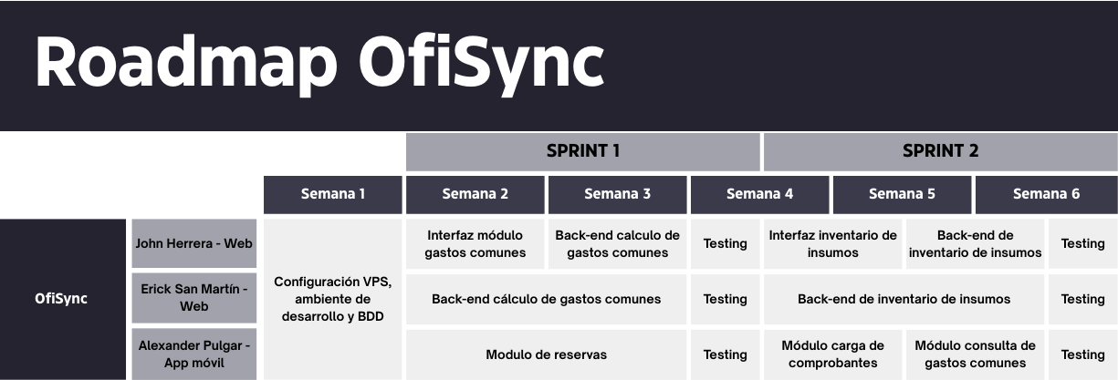
Roadmap

Slide 10
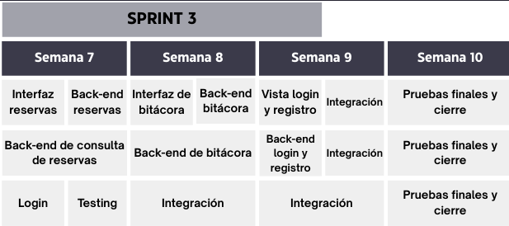
Roadmap

Slide 11
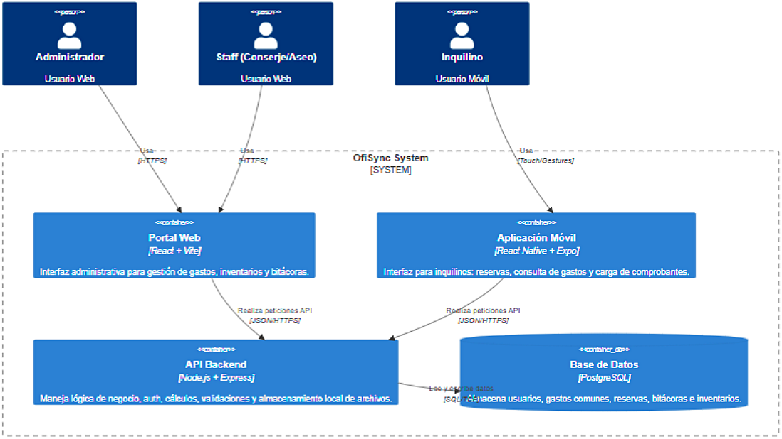

Slide 12
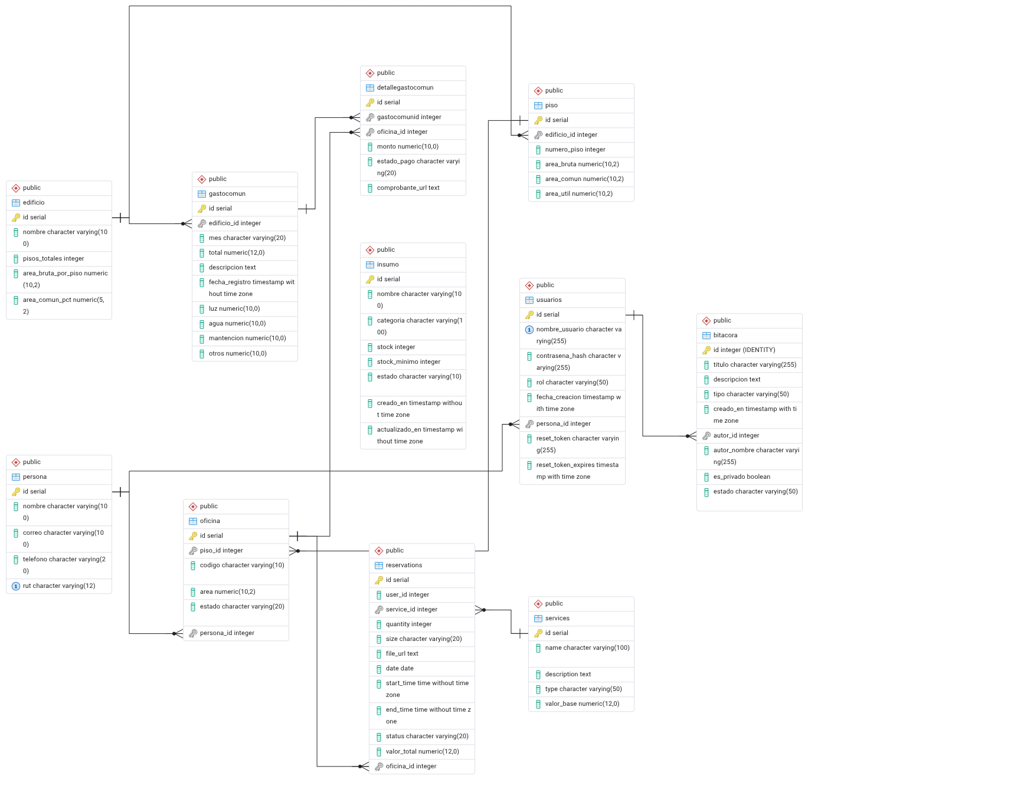
Data model

Slide 13
Data model
Physical infrastructure
Services and reservations
Inventory
  Building
  Floor
  Office
  Services
  Reservations
  Supplies
People and security
Financial
  Person
  Users
  Logbook
  CommonExpense
  CommonExpenseDetails

Slide 14
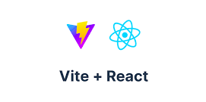








Technologies used

Slide 15
Demonstration

Slide 16
Incompatibility with the initial stack model (Django/Ionic).
Lack of knowledge about the testing process.
Obstacles
Failure to accurately estimate the original time frame.

Slide 17
Questions

